Slide 1

Property MANAGEMENT
DAMG6210 - Data Management and Database Design
NAME | NUID | EMAIL
Rishikesh | Pranav | Himavanth Sai Ram
002866379 | 002922546 | 002833360
cherodath.r@northeate rn.edu | rajavelusivakumar.p @northeastern.edu | chitrala.h@northeastern. edu

Slide 2
Overview:
Streamlined Property Management System:
Purpose: Designed to optimize property management tasks, with a focus on tenancy, maintenance, and supervision.
Simplified Data Access: Created views to provide users with a straightforward approach to accessing and interpreting data.
Enhanced Security Measures: Established user roles to ensure enhanced security and controlled access to sensitive information. Utilized triggers to automate actions, adding an extra layer of security to the system.
User-Friendly Data Management:
Intuitive Data Access: Utilization of procedures eliminates the complexity of direct SQL queries.
Enhanced User-Friendly Experience: Simplified operations allow users to focus on property management tasks and Reduced learning curve promotes efficiency through easy data manipulation.
Streamlined Maintenance: Users can confidently manage tenancy and maintenance through intuitive procedures.

Slide 3
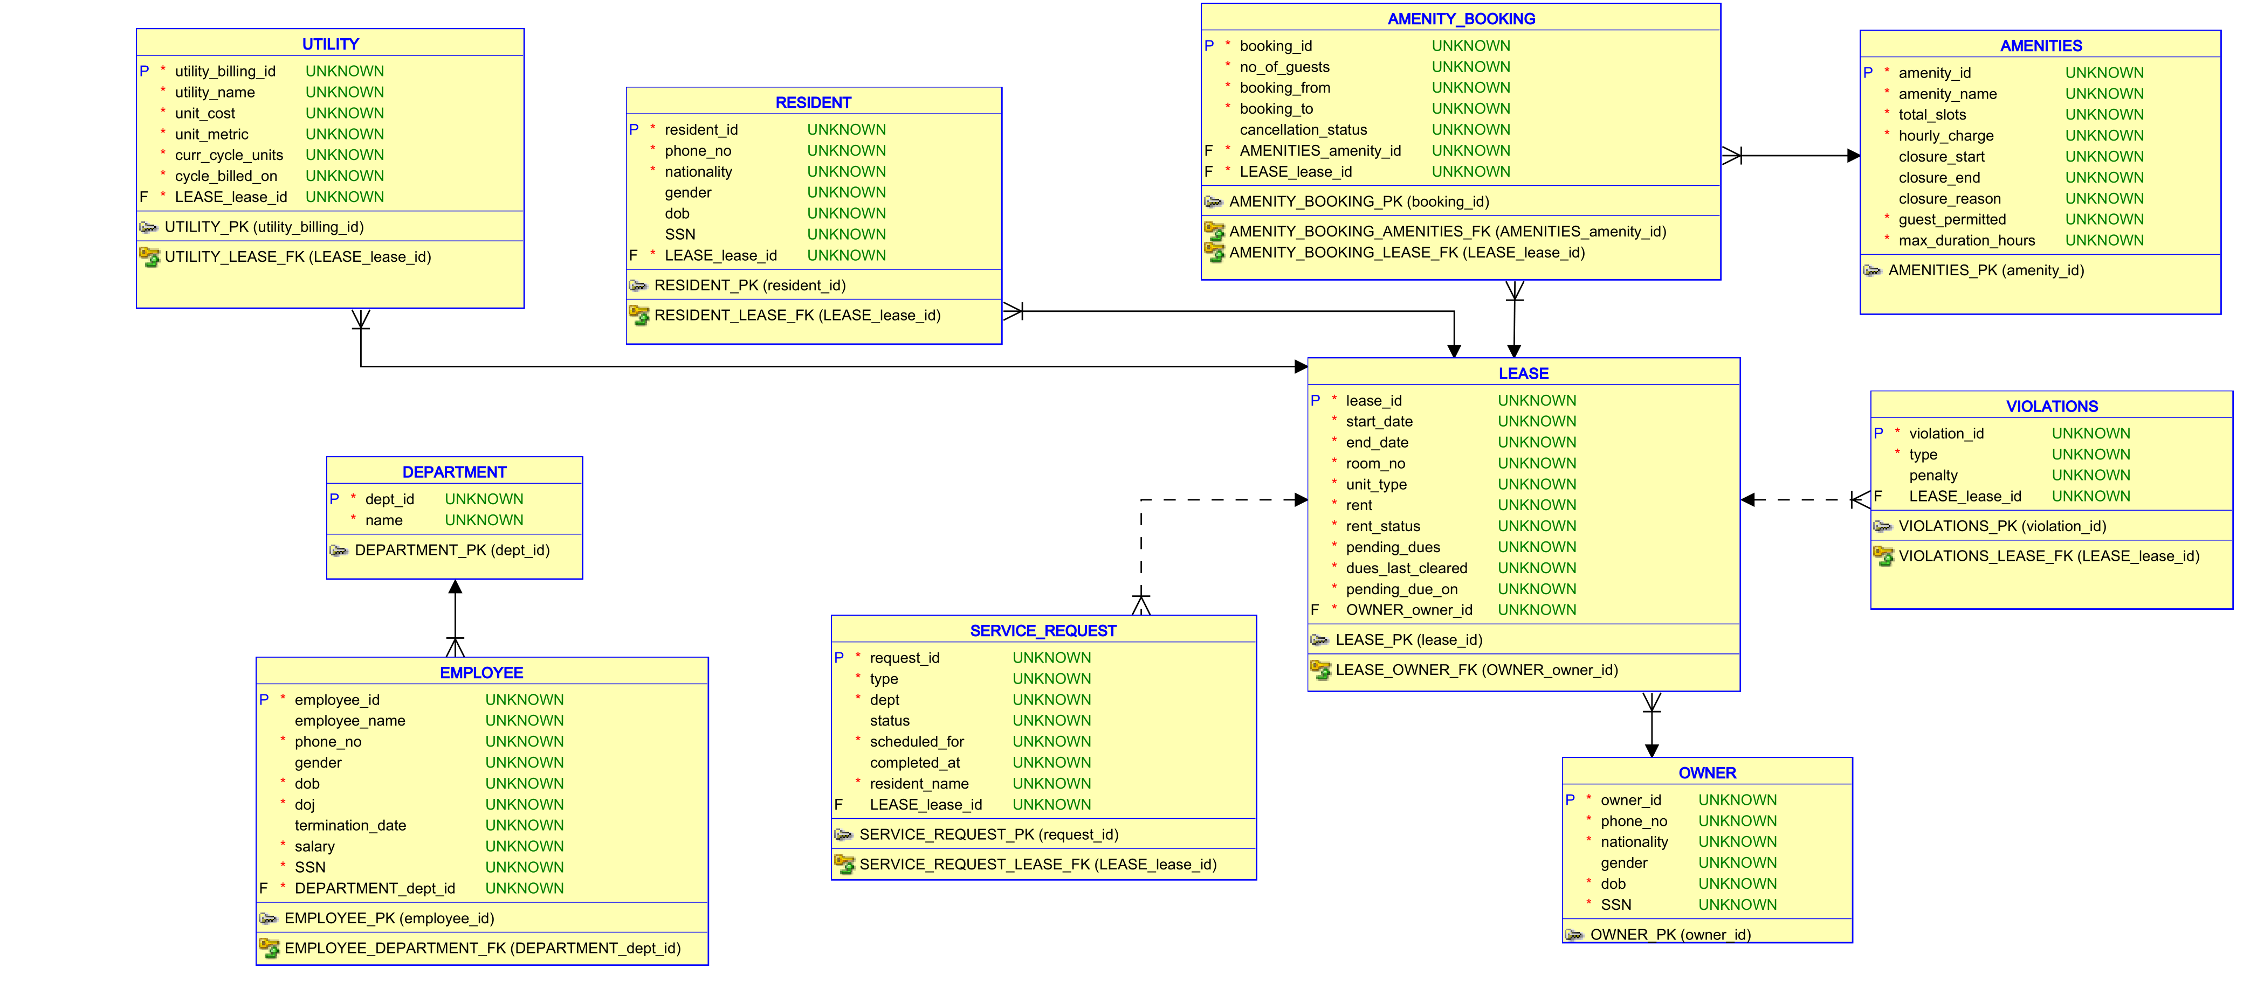

Slide 4
Business Rules
Resident Lease Management:
All resident aspects tied to Lease ID.
Multiple residents under one lease.
Owner Property Ownership:
Owners can possess multiple rooms.
Rent Payment Process:
Rent paid in advance, added to pending dues.
Pending dues cleared before the month begins.
Violation Penalties:
Leasing office adds penalties for violations.
Penalties vary based on severity and recurrence.
Utilities Billing:
Electricity, Water, Gas billed monthly.
Due by the next month, usage updated daily at 12 am UTC.
Amenities Management:
Booking possible 6 days prior.
Closure updates 7 days before and booking cancellation window of 6 hours.
Emergency Amenity Cancellation:
Admin can cancel bookings in emergencies without user charges.
Guest Restrictions:
If amenities don't allow guests, bookings cannot include guests.
Service Requests:
Assignable to departments: Electrical, Plumbing, HVAC, Elevator, General, etc.

Slide 5
Contributions
Name | Role | Procedures | Reports/View
Rishi | Resident | Book_amenity Cancel_amenity Close_amenity Update_utility Onboard_resident | Bookings_view office_view_amenities Resident_utility_usage
Pranav | Leasing Office | Add_Payment, Onboard_Owner, Add_New_Lease, Add_New_Violation Terminate_Lease | Violations_View
Ram | Maintenance | Add_sr, Onboard_employee , Onboard_department, Close_sr, Schedule_emp, Before_sr_insert Fire_emp | Assignments , Service_request_summary_report, Employee_performance_report , Sr_resident

Slide 6
Procedures
Procedure Name | Inputs | Action | User/Role Type
ADD_PAYMENT | LEASE_ID | Logs Rent Payment and clears Dues for the specified Lease | LEASING OFFICE
ADD_NEW_LEASE | OWNER_ID START DATE END DATE ROOM NO, UNIT TYPE, RENT RENT STATUS PENDING DUES DUES LAST CLEARED ON NEXT DUE DATE | Adds a new Lease | LEASING_OFFICE
ADD_VIOLATIONS | LEASE_ID PENALTY TYPE | Adds a violation | LEASING_OFFICE
ONBOARD_OWNER | OWNER_ID OWNER_NAME PHONE_NUMBER NATIONALITY GENDER DOB SSN | Adds a new Owner | LEASING_OFFICE

Slide 7
Procedures
Procedure Name | Inputs | Action | User/Role Type
ONBOARD_OWNER | OWNER_ID OWNER_NAME PHONE_NUMBER NATIONALITY GENDER DOB SSN | Adds a new Owner | LEASING_OFFICE
TERMINATE_LEASE | LEASE_ID END_DATE | Terminates the Lease | Leasing Office

Slide 8
Procedures
Procedure Name | Inputs | Action | User/Role Type
BOOK_AMENITY | LEASE_ID, AMENITY_NAME NO_OF_GUESTS BOOKING_FROM BOOKING_TO | Books Amenity for the resident based on input arguments. | RESIDENT
PROCEDURE CANCEL_AMENITY | BOOKING_ID LEASE_ID | Cancels the Amenity based on input arguments. | RESIDENT
PROCEDURE CLOSE_AMENITY | AMENITY_ID, CLOSURE_START DATE CLOSURE_END DATE CLOSURE_REASON | Closes or Ceases the Amenity from booking based on input arguments.
UPDATE_UTILITY | UTILITY_NAME LEASE_ID UNITS_ADD | Adds Utility Usage based on input arguments
ONBOARD_RESIDENT | RESIDENT_NAME PHONE_NO NATIONALITY GENDER DOB SSN LEASE_ID | Onboard a resident with lease ID based on input arguments

Slide 9
Procedures
Procedure Name | Inputs | Action | User/Role Type
ADD_SR | LEASE_ID RESIDENT_NAME SERVICE | Adds service request based on input arguments | MAINTENANCE
ONBOARD_EMPLOYEE | EMPLOYEE_NAME PHONE_NO GENDER DOB SALARY SSN DEPARTMENT_DEPT_ID | Onboards employee based on input arguments | MAINTENANCE
ONBOARD_DEPARTMENT | DEPT_ID NAME | Onboards department based on input arguments | MAINTENANCE
CLOSE_SR | REQUEST_ID | Completes SR and Updates Resp Tables. | MAINTENANCE
SCHEDULE_EMP | REQUEST_ID EMP_ID | Manual Assignment of SR to respective employee of that department. | MAINTENANCE
FIRE_EMP | EMP_ID NAME | Fires an Employee and Reassigns existing SRs to another available employee. | MAINTENANCE
BEFORE_SR_INSERT | TRIGGER | Automatically Assigns an Employee after an SR is raised by resident. | MAINTENANCE

Slide 10
Reports
View | Description
OFFICE_VIEW_AMENITIES | Shows which resident has booked what amenity and when
RESIDENT_UTILITY_USAGE | Shows what amenity was booked by the resident
ASSIGNMENTS | This View will populate individual assignments of each employee to the assigned service request.
SERVICE_REQUEST_SUMMARY_REPORT | This view will populate the quantity of service requests being handled by each department
EMPLOYEE_PERFORMANCE_REPORT | This view will populate each employee’s performance with assignments vs completions of service requests.

